Slide 1
Lecture 05 - Feature Extraction
Prof. André Gustavo Hochuli
gustavo.hochuli@pucpr.br
aghochuli@ppgia.pucpr.br
Notes:
Prof. André Hochuli

Slide 2
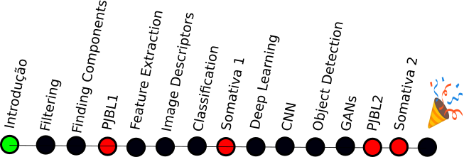
Topics
Discussion of PJBL #01
Feature Extraction
Feature Vector
Feature Space
Feature Engineering
Image Descriptors
Vertical and Horizontal Projections
Practice
Computer Vision - Prof. André Hochuli
Lecture 05
Notes:
Prof. André Hochuli

Slide 3
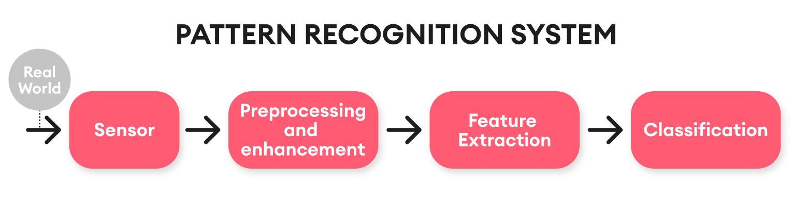
Computer Vision & Pattern Recognition Pipeline
Computer Vision - Prof. André Hochuli
Lecture 05
Notes:
Prof. André Hochuli

Slide 4
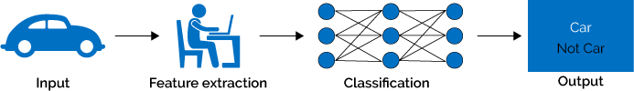
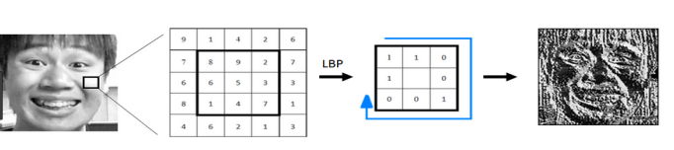
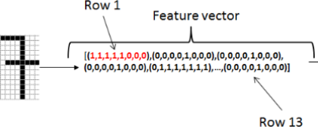
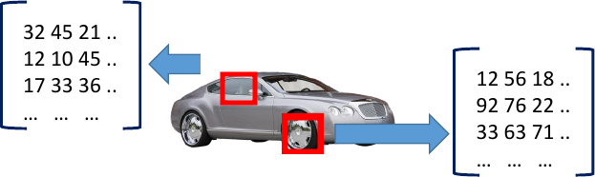
Feature Extraction
A feature descriptor translates high-dimensional data to a feature space
A feature vector represents the input data produced by the feature descriptor
Later, a machine learning model will learn the representations
Computer Vision - Prof. André Hochuli
Lecture 05
Notes:
Prof. André Hochuli

Slide 5

Feature Extraction
Let's represent our image by its size, so an image I that belongs to class X is represented by:
f(I,X) = [I.width,I.heigth,X]
Computer Vision - Prof. André Hochuli
Lecture 05
Notes:
Prof. André Hochuli

Slide 6
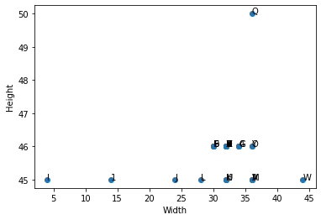
Feature Vector
Is the feature vector representative?
Computer Vision - Prof. André Hochuli
Lecture 05
Notes:
Prof. André Hochuli

Slide 7
Feature Vector
Is the feature vector representative?
Computer Vision - Prof. André Hochuli
Lecture 05
Notes:
Prof. André Hochuli

Slide 8
Feature Vector
Is the feature vector representative?
Computer Vision - Prof. André Hochuli
Lecture 05
Notes:
Prof. André Hochuli

Slide 9
Feature Vector
Is the feature vector representative?
Computer Vision - Prof. André Hochuli
Lecture 05
Notes:
Prof. André Hochuli

Slide 10
Feature Vector
Is the feature vector representative?
Non Discriminative
Computer Vision - Prof. André Hochuli
Lecture 05
Notes:
Prof. André Hochuli

Slide 11
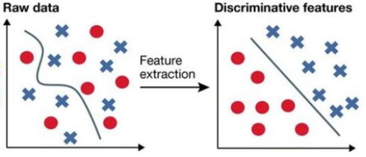
Feature Engineering
How to produce a discriminative feature space?
Features must describe a singular characteristic of the problem for good generalization.
Computer Vision - Prof. André Hochuli
Lecture 05
Notes:
Prof. André Hochuli

Slide 12
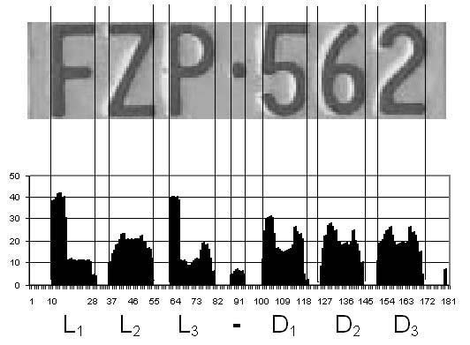
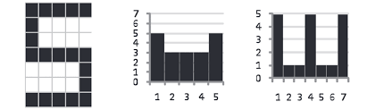

Image Descriptors
Vertical and Horizontal Projection
Computer Vision - Prof. André Hochuli
Lecture 05
Notes:
Prof. André Hochuli

Slide 13
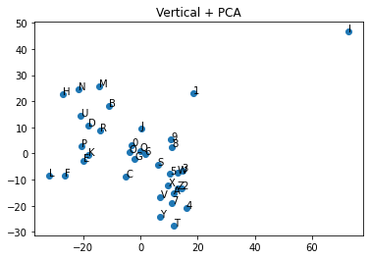
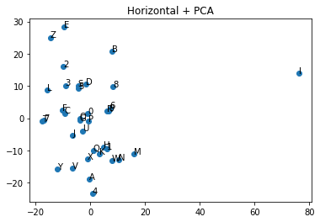
Image Descriptors
Vertical and Horizontal Projection
Computer Vision - Prof. André Hochuli
Lecture 05
Notes:
Prof. André Hochuli

Slide 14
Let’s Code!!
Link
Computer Vision - Prof. André Hochuli
Lecture 05
Notes:
Prof. André Hochuli

Slide 15

Didactic Quality Questionnaire
Let me know your thoughts about
Lectures, Didactic, Materials and Professor
https://forms.office.com/r/4ewHS74yrK
Computer Vision - Prof. André Hochuli
Lecture 05
Notes:
Prof. André Hochuli

